Slide 1
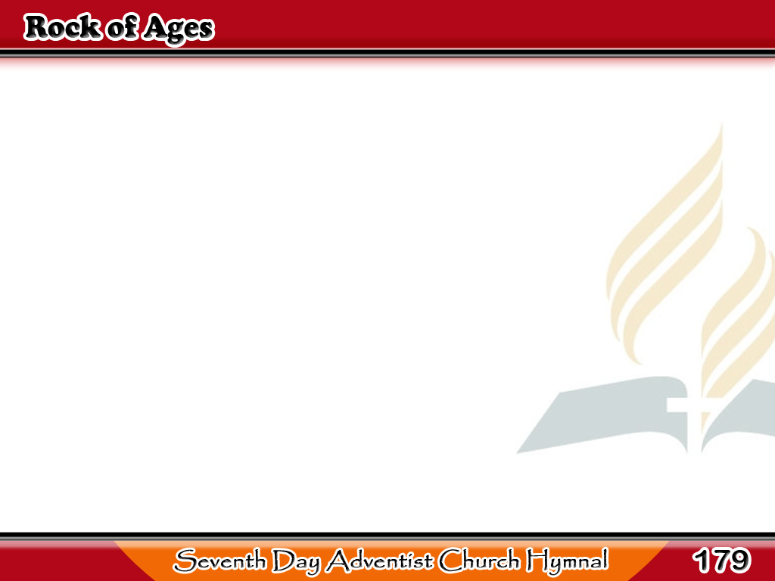
Ikaw ang Batong Buhay
Rock of Ages, cleft for me,
Let me hide myself in Thee;
Let the water and the blood,
From the riven side which flowed
1/3

Slide 2
Ikaw ang Batong Buhay
Be of sin the double cure,
Cleanse me from
its guilt and power.
1/3

Slide 3
Ikaw ang Batong Buhay
Not the labors of my hands
Can fulfill Thy law’s demands;
Could my zeal no respite know,
2/3

Slide 4
Ikaw ang Batong Buhay
Could my tears forever flow,
All for sin could not atone;
Thou must save, and Thou alone.
2/3

Slide 5
Ikaw ang Batong Buhay
When my pilgrimage I close,
Victor o’er the last of foes,
When I soar to worlds unknown,
3/3

Slide 6
Ikaw ang Batong Buhay
And behold Thee on Thy throne,
Rock of Ages, cleft for me,
Let me hide my self in Thee.
3/3

